Slide 1
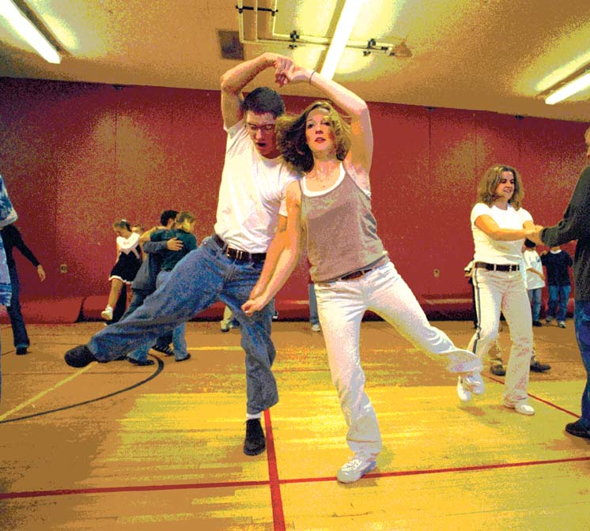
A Step by Step Guide
How to write a valid and reliable knowledge test?

Slide 2
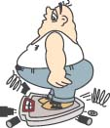
How to write a knowledge test?
Step 1: Identify the content knowledge based on the standards
For example:
PE.6.HF.3.2: Use a variety of self-paced aerobic activities, keeping in the appropriate target heart rate zone/perceived exertion levels, including cool-down and appropriate post-activity stretching.
What knowledge do students need to master to reach the specified goal?
Procedural knowledge? Declarative knowledge?

Slide 3
Standards: The departure!
PE.6.HF.3.2: Use a variety of self-paced aerobic activities, keeping in the appropriate target heart rate zone/perceived exertion levels, including cool-down and appropriate post-activity stretching.
Declarative knowledge (what): aerobic; anything else?
Procedural knowledge (how): pacing; anything else?

Slide 4
Step 2: Matrix for Assessment
You will not miss any significant knowledge component!
PE.6.HF. 3.2. | PE.6.HF.3.3 | PE.6.HF.3.4 | PE.6.HF.3.5
Aerobic activity
HR range for aerobics
Perceived effort zone/HR for aerobic
Implementing pacing
Warm-up; cool down

Slide 5
Who/How to decide the most important content for testing?
The test is costly (paper, resources to prepare and monitor tests, and instruction time, etc).
We all want to use the least number of questions to accurately capture the students’ learning achievement.
We often use “Panel Methods” to establish the validity of the test. It is to make sure the test is actually testing what it means to test.
  Panel is composed of several experts
  Panel members make collective decision on the content to be tested.

Slide 6
Step 3: Content Validation Meeting Results (PE.6.HF.3.2)
A consensus is achieved on writing four questions
 | Aerobic exercise | HR range for Aerobic | Perceived Effort | Pacing implementation | Warm-up; cool down | stretching
Joey | √ |  | √ | √ | √
Richard | √ | √ |  |  |  | √
Nick | √ | √ |  | √ |  | √
Makayla | √ |  | √ | √ |  | √

Slide 7
Step 4: Choose the best approach to measure knowledge
True/False
Multiple choices
Filling blanks
Matching
Ranking
Essays
Short-answer
Do you know the advantages/disadvantages of each?

Slide 8
Step 5: Collective Drafting/Revision Process
Makayla is responsible for writing a question on Stretching. Others are responsible for rating and providing constructive feedbacks.
Makayla: To reduce muscle stiffness, we should ____ after intensive physical activities. A. Drink sport drink; B. Relax; C. Do stretching; D. Log our activities
Joey | Good item/A/100%
Richard | Good item | Maybe add “and prevent injuries” after “reduce muscle stiffness. ”
Nick | Good item | Maybe replace “D. log our activities” with “Doing mild exercises.”

Slide 9
Step 6: Test your questions!
Reliability
Face Validity
Difficulty Level
Discrimination Level
It is the time for you to revise the questions based on the feedback from your students!

